Slide 1
Software Testing Project
Online Banking System

Slide 2
Team Members
Yassin Khaled Mostafa Attia 19P9597
Yara Mostafa Ibrahim 19p1120
Gannah Allah Mohamed 19p9610
Ziad Ashraf Ahmed Kasem 19p7095
Seifeldin Sameh 19p3954
Adham Ehab Salman Selim 19p4388

Slide 3
Our banking system contains three main classes
Client
Transaction
account

Slide 4

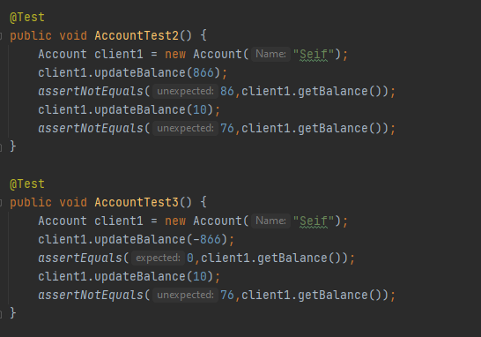
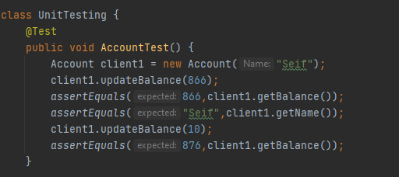
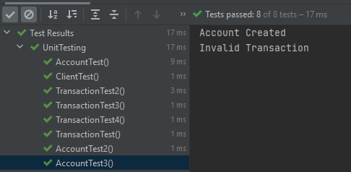
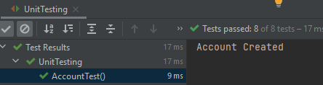
Unit Testing
Each function was tested individually to make sure that the foundations are correct.
The following is sample from each class testing:
Account class test:

Slide 5
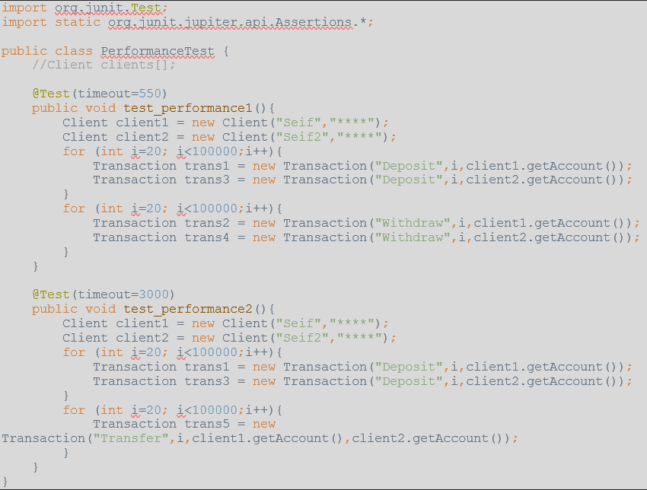
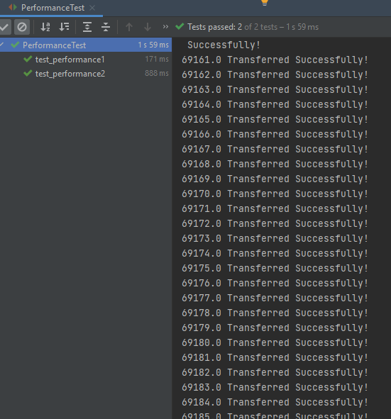
Performance Testing
the aim of performance testing to make sure that neither a conflict nor fault would appear when too many clients uses the system or many orders where given to the system.
We tested the deposit ,withdraw and transferring money from a client to other and no fault appeared. For Example:

Slide 6
Integration Testing
we adopted a bottom up approach as starting at the bottom of the hierarchy again means that the critical modules are generally built and tested first and therefore any errors or mistakes in these forms of modules are identified early in the process.

Slide 7
last stage in integration testing we tested the whole system and the connection between the classes and their functions.
Faults appeared during testing:
The withdraw function used to withdraw negative money amounts leading to an increase in the balance.
The issue was solved successfully.

Slide 8
Thank You!

